Slide 1
Using Github and Submitting HW

Slide 2
Slack Channel!! molsim-115.slack.com
Notes:
-> Use slack to figure out how to do HW
-> Use slack to bug me and other instructors ☺

Slide 3
Why do we need github? I stole these slides from Dave Beck (without his permission please don’t tell on me)

Slide 4
What is version control
Version control is like a combination of undo and track changes for your code
You can revert to previous versions of code
You can easily identify who contributed what
Version control is about tracking versions of code and developing software with people

Slide 5
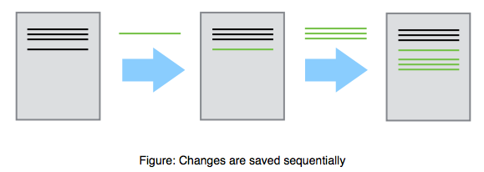
What is version control?
Notes:
Dave likes to use the example of writing a manuscript with your advisor

Slide 6
Why do I need version control?
You have a working piece of software
You add some new features
Everything is broken
You want to revert to the last known working version

Slide 7
Why do I need version control?
You have a working piece of software
You add some new features
Everything is broken
You want to revert to the last known working version

Slide 8
Why do I need version control?
You are developing software with other people
You want to be able to identify and resolve conflicts during code development
Two people working on the same function at the same time
You need to be able to identify who is responsible for what pieces of code

Slide 9
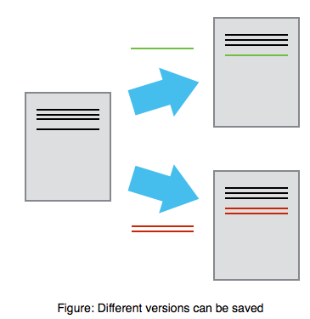
Why do I need version control?

Slide 10
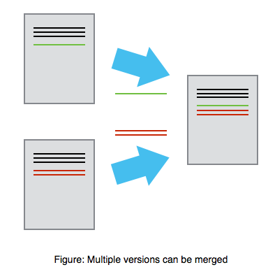
Why do I need version control?
Mary
Alice

Slide 11
Why else?
You want a job
No one will hire a software developer that doesn’t know how to use version control

Slide 12
What is git?
Git is the most popular version control software
Git is open source
Git runs on every platform
even Plan 9 From Outer Space
Git is better than all previous version control tools (in my opinion, and I’ve used quite a few) (I am not as old as Dave. Git is all I know and I love it)

Slide 13

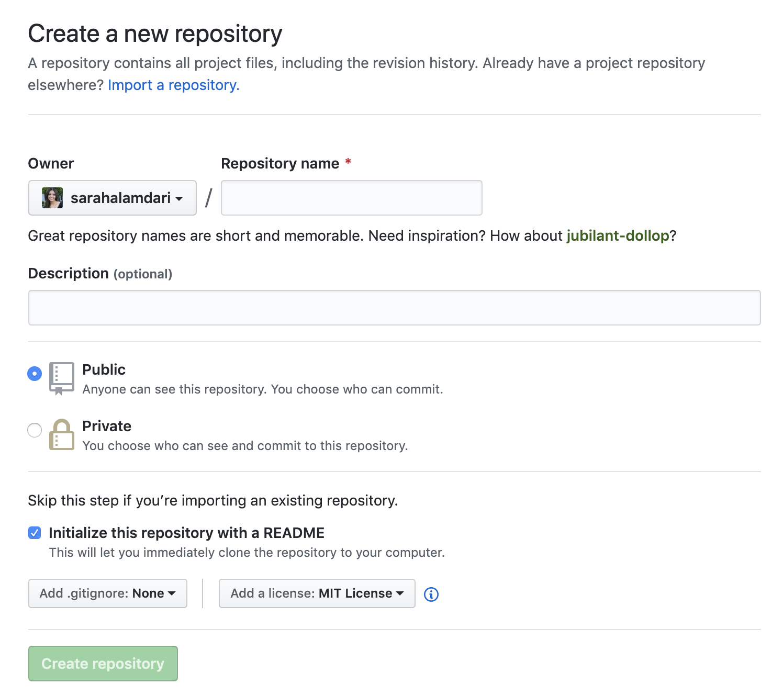


Github Terminology
Repository: think of this as a “Project Folder”, can be public or private, can have many contributors. Is located on both your local computer, and hosted on github’s online server for maximum collaboration –> double edged sword (SAVE, SAVE, SAVE!!)
Local Machine
Github Server
(Remote)
Notes:
Note: There are two ways to create a repository on github. In this method, we create it on Github, and clone it onto our local machine.

Slide 14
In class activity #1: Make your own github repo

Slide 15
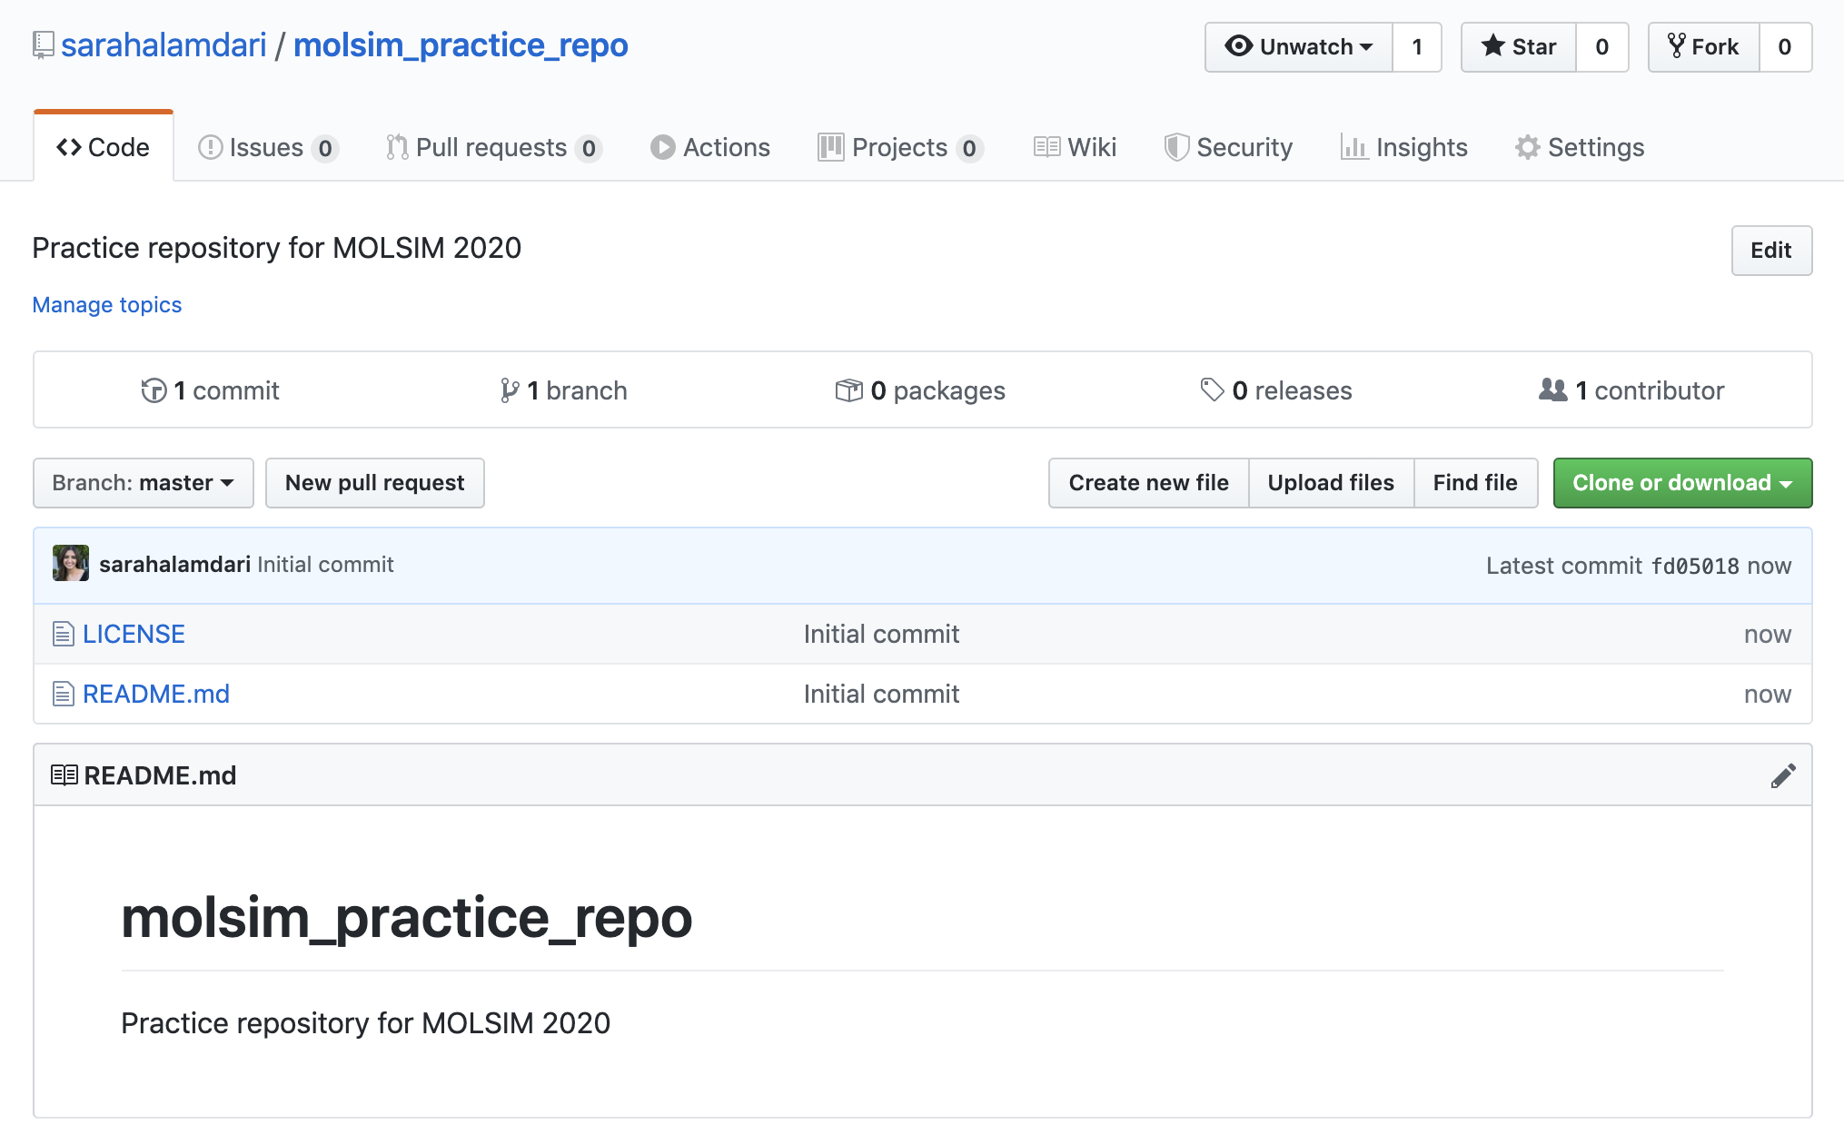

Slide 16
Clone the Repo onto your Computer
Clone: make a local copy of the repository on your computer
git clone https://github.com/sarahalamdari/molsim_practice_repo.git

Slide 17
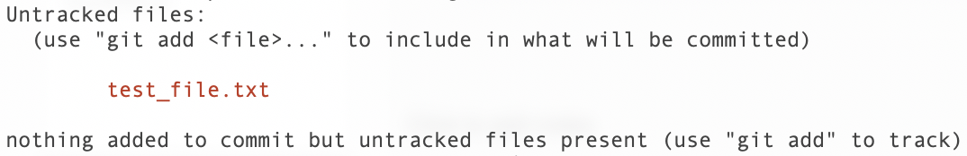
Let’s create a file in our new repository
vi test_file.txt #add some text to this file, save then quit
git status
Notes:
What we’ve done is create a file in the local copy of the repository, but we need to add these changes to the remote copy

Slide 18
Navigating How Github Works
Once you push there is a very high probability of finding this version of your code somewhere in githubs history, in case something goes awry!
*** Each “push” has a token associated with it that you can “git checkout” but we will get to that later (maybe)
Notes:
There is no version control if you DO NOT PUSH. ALWAYS GIT PULL, ADD, COMMIT, PUSH.

Slide 20
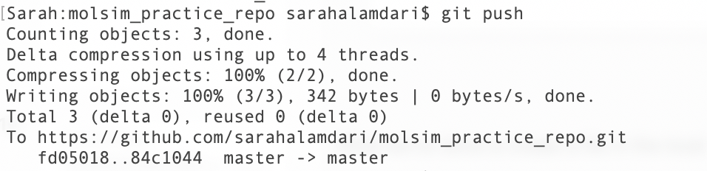
Now we can push those changes to remote
git pull origin master # ALWAYS PULL BEFORE MAKING CHANGES!!!
git add test_file.txt #add file to the staging area
git commit –m “add test file to my repo” #commit changes to your local repo, # with a 1-line message about your # changes
# You could also use git commit (without –m) for longer messages → will open # a text editor
git push origin master #push changes to remote (this is equivalent to git push)
Notes:
What we’ve done is create a file in the local copy of the repository, but we need to add these changes to the github copy

Slide 21
Github for Collaboration
Two main methods of making edits to a repository
Branch: parallel version of a repo (Better for collaboration IMO) -> Can update with “master” through 2 mechanisms 1) push, or 2) pull request
Fork: personal copy of someone’s repo (Better for jacking someone else’s work, i.e. building code on top of established software, etc) -> can only update through pull-requests
Pull Request: Request to merge to versions of a repo (git push is a type of merge as well)

Slide 22

Creating branches
git branch # check which branches are there
git checkout –b branch_name # create a new branch and go to that branch
git checkout branch_name # checkout an existing branch
Merging Branch With Master: Recommended Route for code management)
git add
git commit –m “message”
git push origin new_branch
---> NOW LETS GO TO GITHUB < ---
Notes:
What we’ve done is create a file in the local copy of the repository, but we need to add these changes to the github copy

Slide 23
Dangerous merging tactics:
git add
git commit –m “message”
git push origin new_branch
---> NOW LETS GO TO GITHUB < --- # Skip making a pull request
git checkout master
git pull origin master #always pull before making new changes!
git merge new_branch
git push origin_master
Notes:
This method works well if you are collaborating on code by yourself or if you are lazy.

Slide 24
When you are done with your branch
git branch –d new_branch # ☹
Notes:
This method works well if you are collaborating on code by yourself or if you are lazy.

Slide 25
Homework Assignment
1) Upload your homework from last week to github using a pull-request! (you can use branches or forks) whatever floats your boat !
2) Getting started on hyak? Sign up for access to STF nodes

